Slide 1

NASA Space grant Science Writing 2019-2020
Christianna Reinhardt
Northern Arizona University
Mentor: Chris Etling, Managing Editor, Arizona Daily Sun

Slide 2

INTRODUCTION
2019-2020 Science Writing position
Three* science articles fitting NASA’s mission to reach a general audience published in the AZ Daily Sun, Flagstaff, AZ
Objectives: science communication
*Modified from six due to changes in the Spring 2020 Academic semester due to COVID-19

Slide 3

Opportunities to Connect and Inspire
Astronaut Charlie Duke – 50 years of Apollo Mission
Astronaut Mark Kelly – Sleep Science
Bone Loss in Astronauts After Space Travel
Lowell Observatory’s Long View*
90 Years of the Discovery of Pluto*
1
2
3
4
5

Slide 4

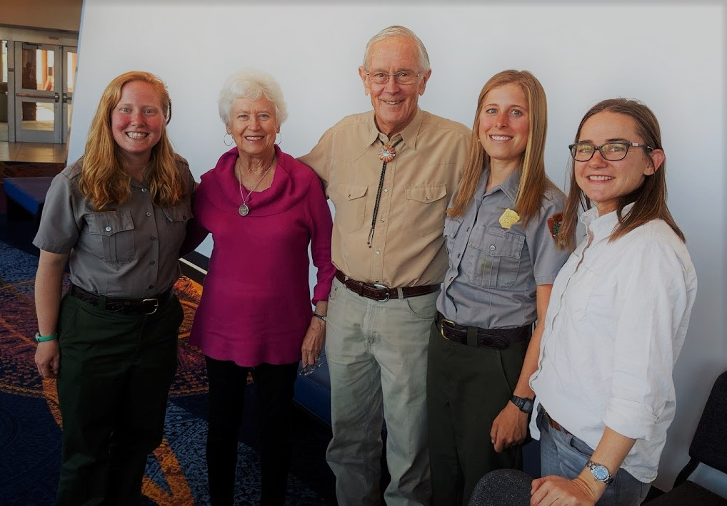
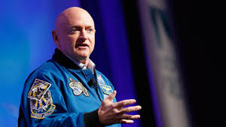
How We Connected
Astronaut Charlie Duke
Inaugural I Heart Pluto Event
Astronaut Mark Kelly

Slide 5
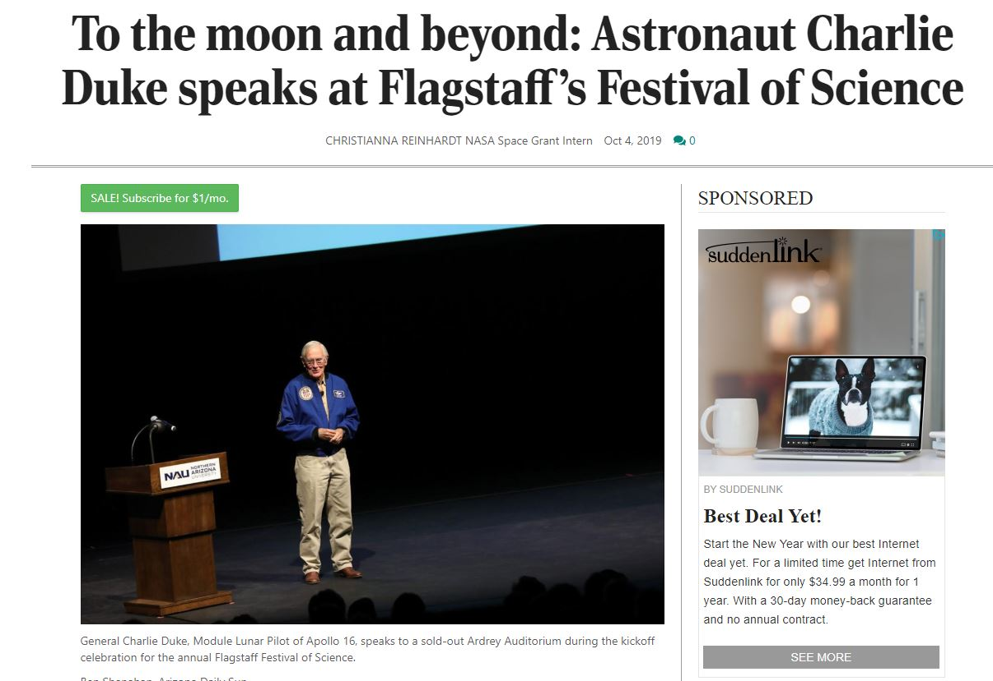
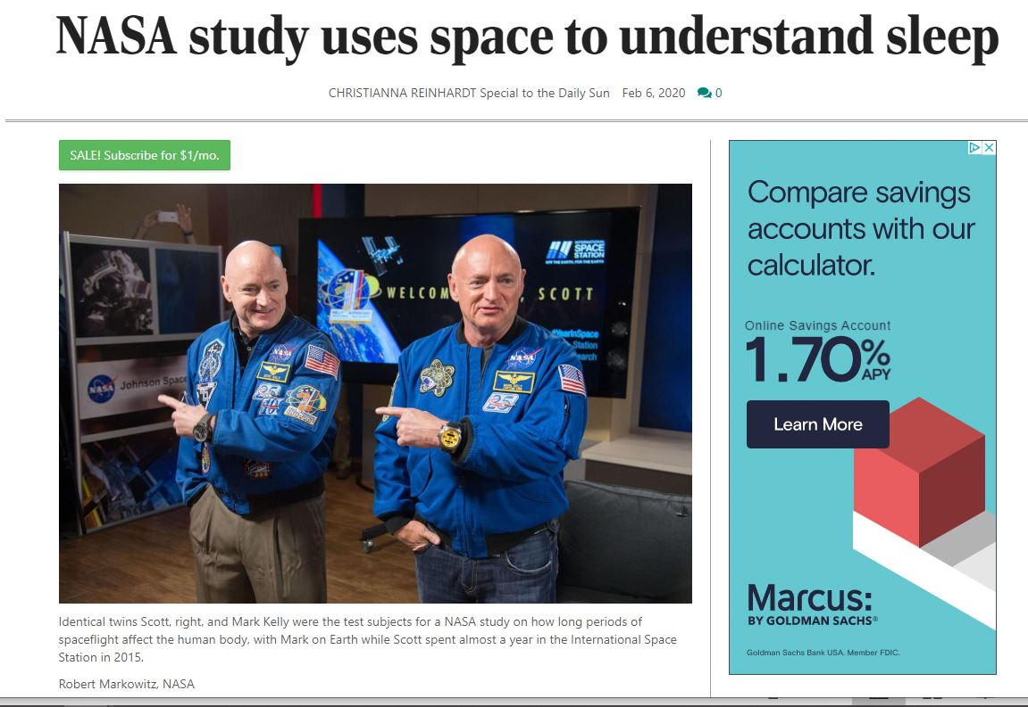
How We Connected

Slide 6


Collecting Data (facts) as a Science Journalist
1
2
3
Fact-check every fact with three different credible sources
Fact-check every quote with a three-part closed loop
Even paragraphs come in threes: three sentences minimum per graf

Slide 7
What’s credible?
1
2
3
Academic, peer-reviewed journals from Science and Medicine
Most referenced:
Nature, Journal of American Medicine
Government information websites
Most referenced:
NASA, Center for Disease Control, National Institute of Health, National Center for Biotechnology Information
Verified university research sites
Most referenced:
Mayo, Cleveland Clinic

Slide 8


What’s Not Credible?
1
Blogs, Vlogs, scientist-friends
Wikipedia, Reddit (Anything Crowdsourced)
Google’s definition of something
Goop.com, verywellhealth.com, etc
CAN INSPIRE, BUT NOT CONFIRM
KNOW WHO FUNDS YOUR SOURCES
2
3
4

Slide 9
Conclusions
1
2
3
Be humble: New discoveries are made every day in science
Engage your reader with a story first, then hook them with science
Don’t be afraid to use analogy to explain a difficult concept

Slide 10




ACKNOWLEDGEMENTS
Dr. Nadine Barlow – our fearless leader!
Chris Etling – Managing Editor, Arizona Daily Sun

Slide 11
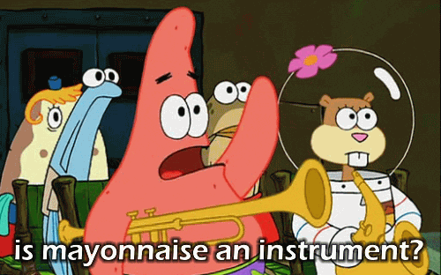
QUESTIONS?
Thank you for your time!
?
5

